Slide 1






THE POWER OF
Rodrigo Fernandes, September 19, 2022
rodrigoefernandes@gmail.com

Slide 2

TABLE OF CONTENTS
Introduction
Key Takeaways
What is IAC?
What is Terraform?
Life without Terraform
Features of Terraform
How to use Terraform?
Example of Terraform Code
How does it work?
Common use cases

Slide 3



INTRODUCTION
WE ALL WANT TO DO OUR TASKS BETTER AND FASTER
WE ALL WANT MORE FREE TIME
FOR FAMILY, LEISURE, LEARNING, OR FOCUSING ON OTHER PROJECTS
TODAY WE WILL LEARN ABOUT AN INFRASTRUCTURE AS A CODE TOOL THAT HELPS A LOT WITH THAT:

Slide 4





BUT FIRST, WHAT IS IAC?
Infrastructure as Code (IaC) is the managing and provisioning of infrastructure through code instead of through manual processes.
THERE ARE OTHER TOOLS SUCH AS:
AZURE RESOURCE MANAGER
GOOGLE CLOUD DEPLOYMENT MANAGER

Slide 5





WHAT IS TERRAFORM?
Multi-Cloud and Hybrid-Cloud Deployments in human readable configuration files.
Files can be versioned, reused, and shared
Open source infrastructure as code tool provided by HashiCorp
Manage low-level components like compute, storage, and networking resources
High-level components like DNS entries and SaaS features

Slide 6





WHAT IS TERRAFORM?
Declarative
High level reusable syntax
Generate and execute plans based on your desired end state and re-provision infrastructure based on configuration changes.
Environment Parity
Execution Plans before applying

Slide 7



LIFE WITHOUT TERRAFORM
Managing infrastructure deployed on different cloud providers
Logistical nightmare
High Operational Costs

Slide 8

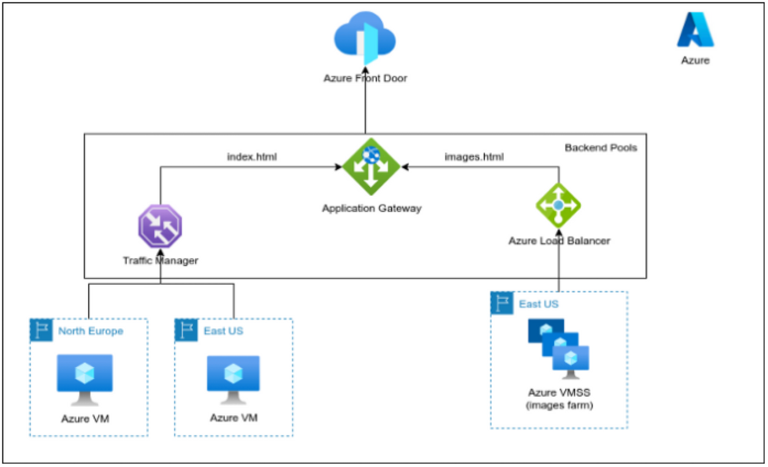
Provisioning without Terraform:

Slide 9

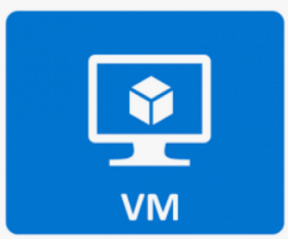
SERVERS VMS

Slide 10
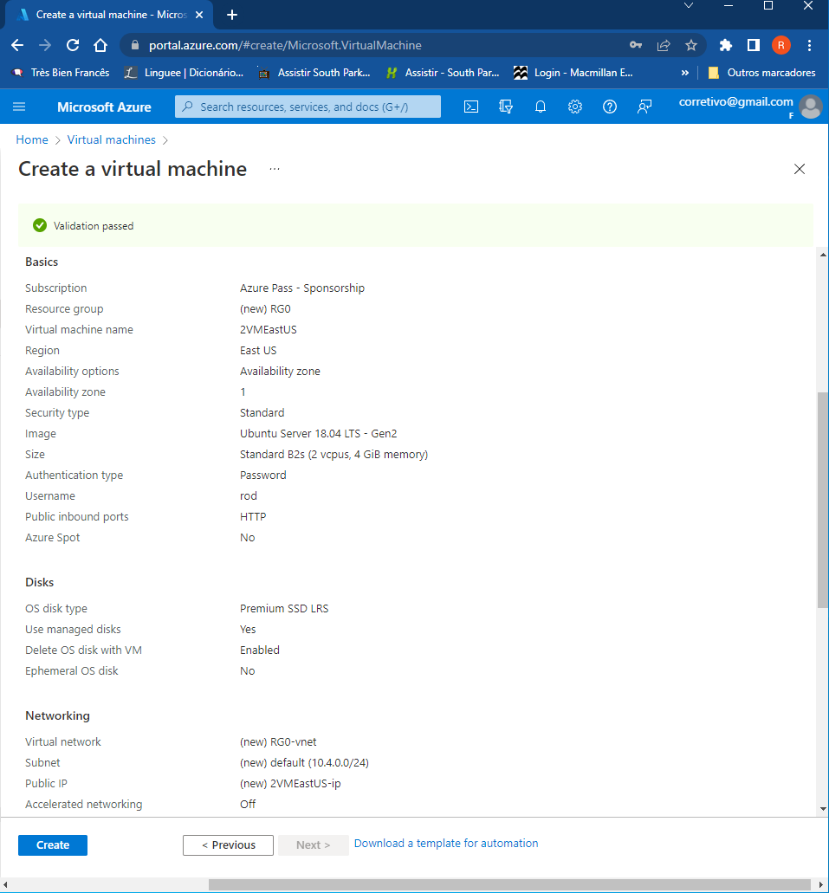
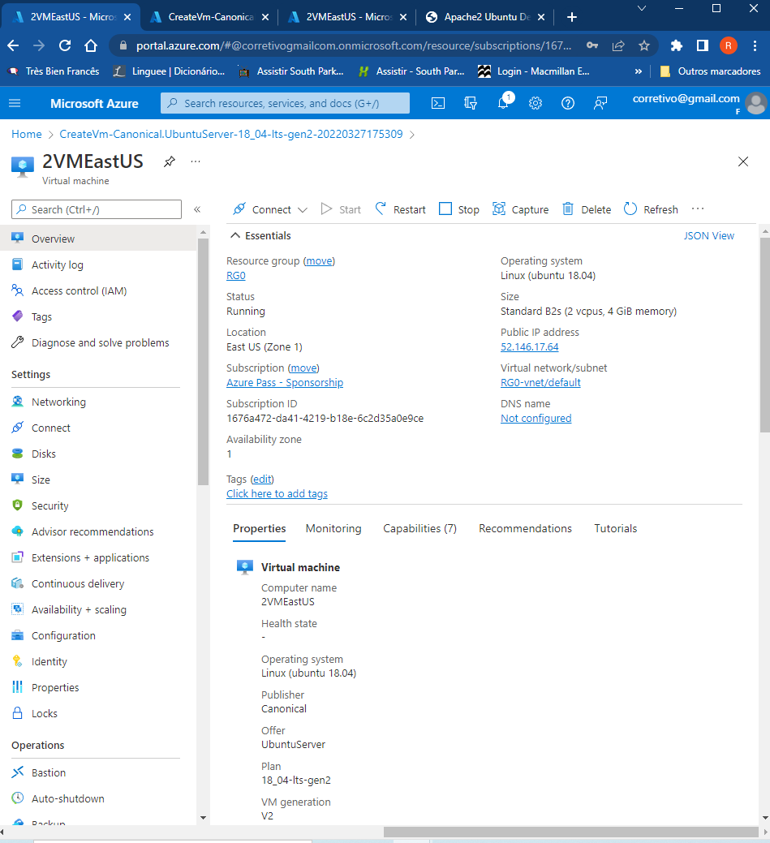
10

Slide 11
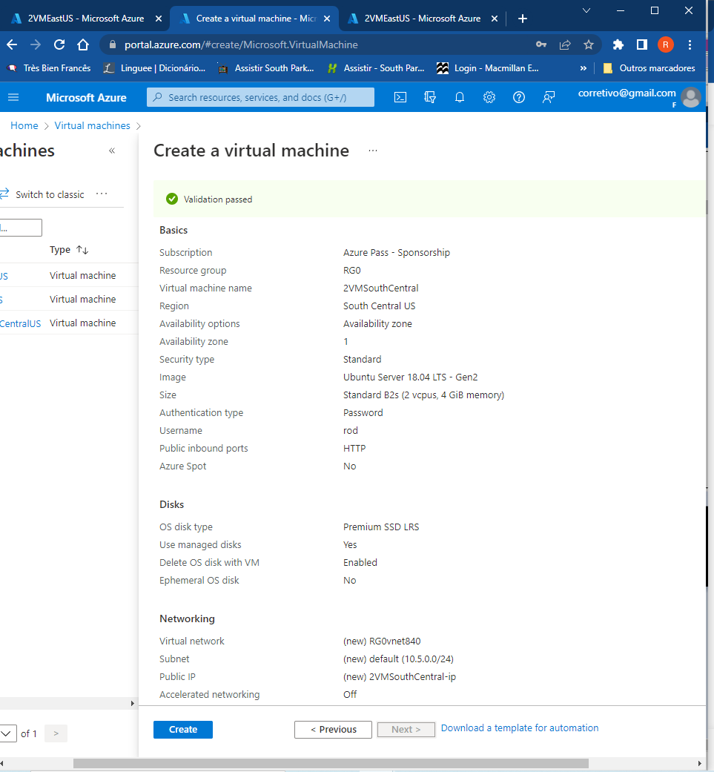
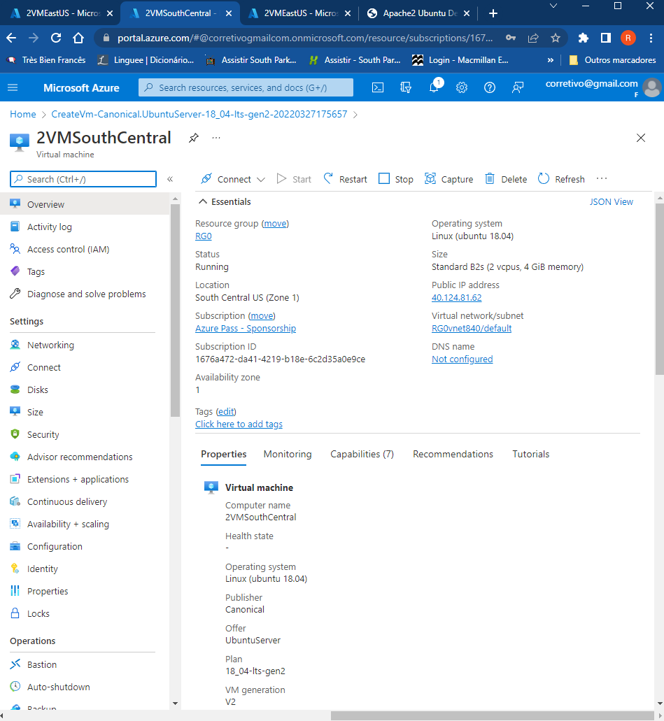
11

Slide 12

IMAGE FARM SCALE SET BEHIND LOAD BALANCER

Slide 13
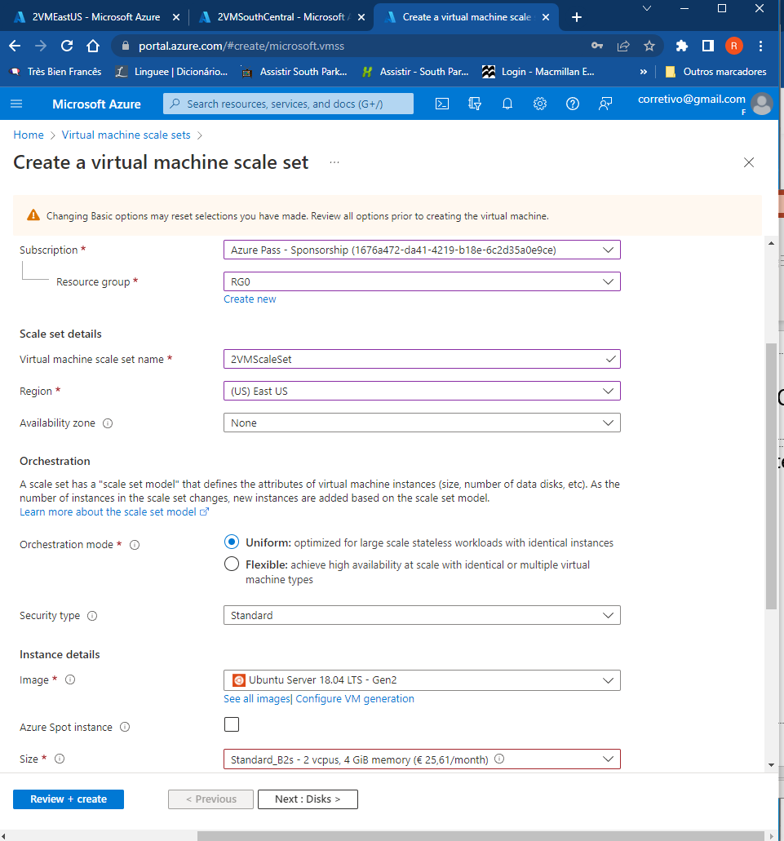
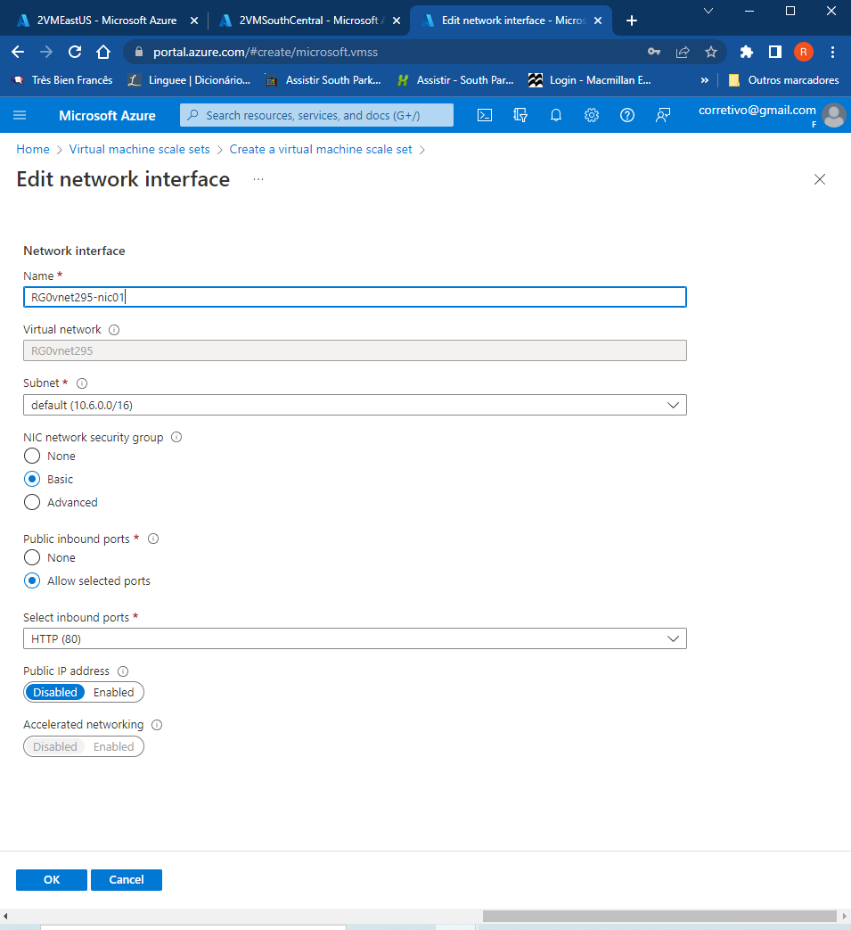
13

Slide 14
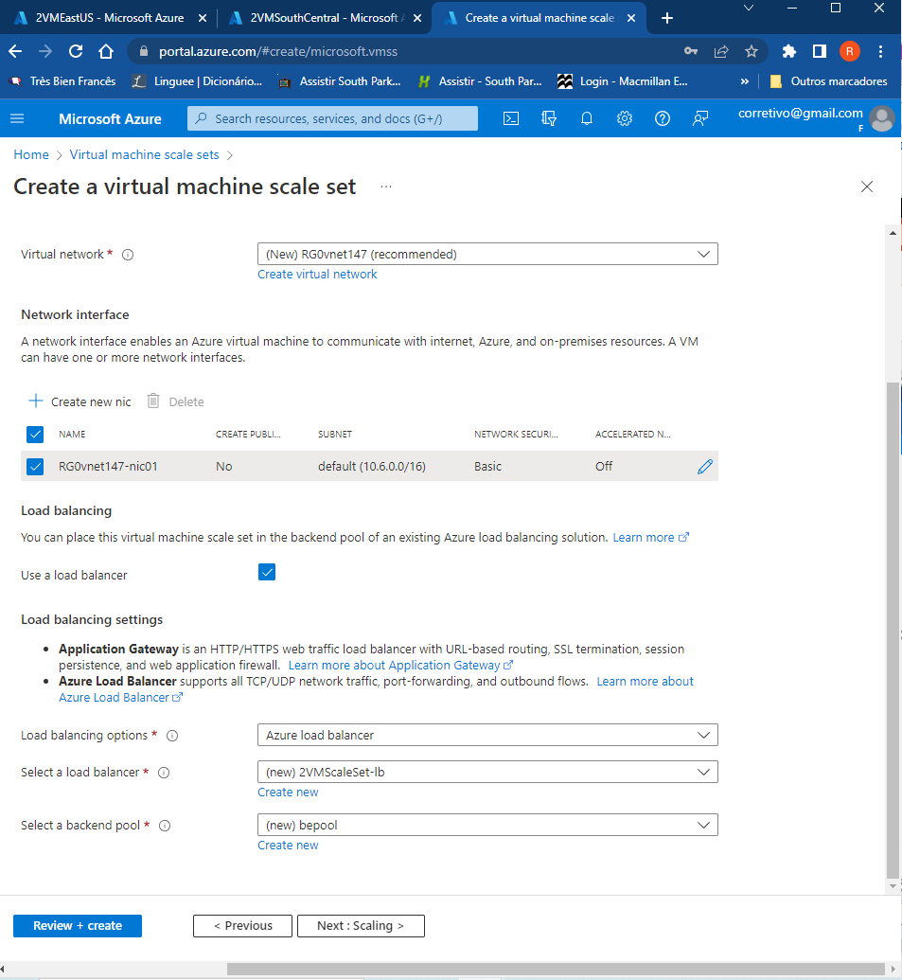
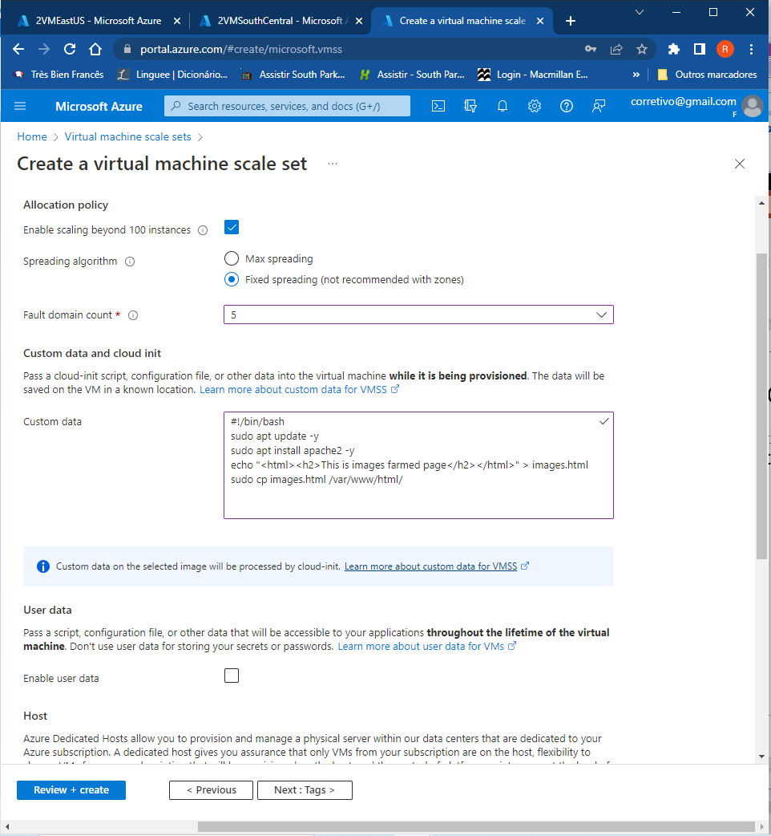
14

Slide 15
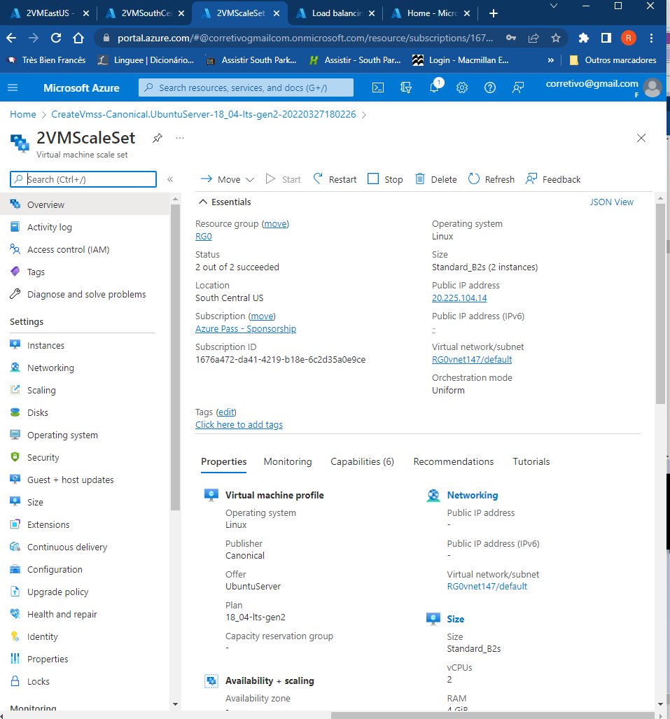
15

Slide 16

TRAFFIC MANAGER
16

Slide 17
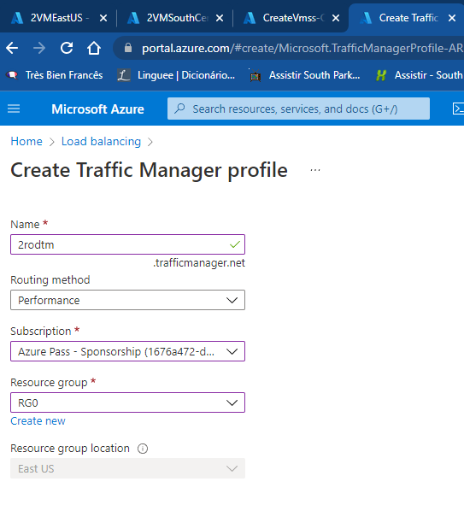
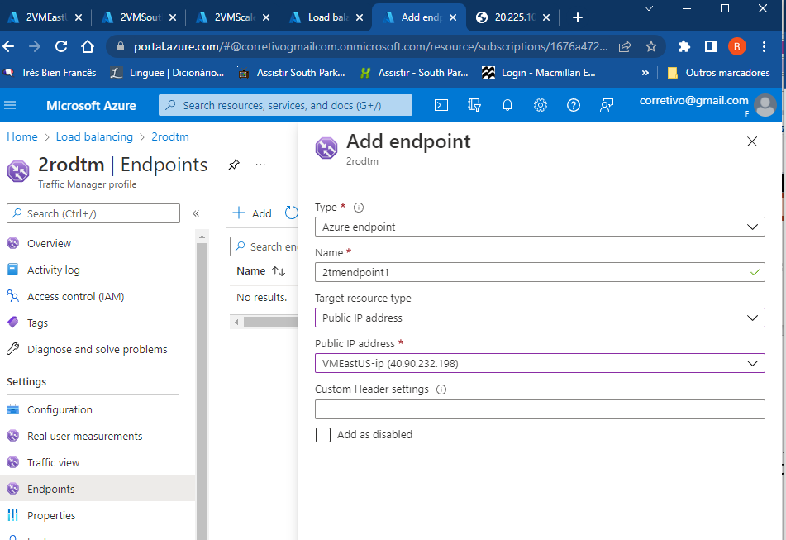
17

Slide 18
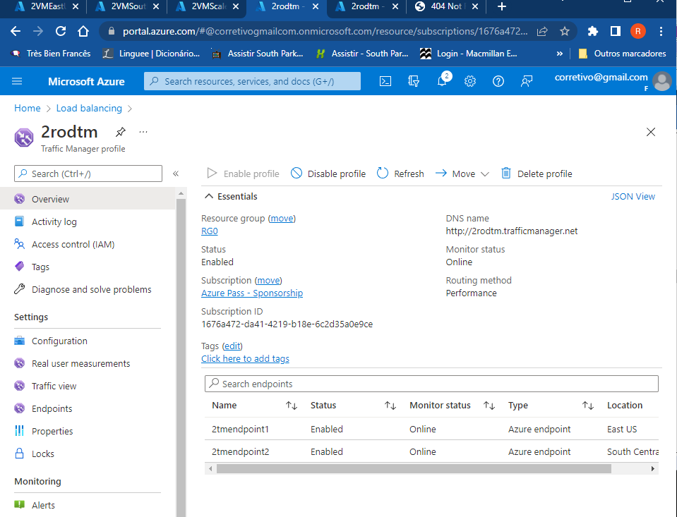
18

Slide 19

APPLICATION GATEWAY
19

Slide 20
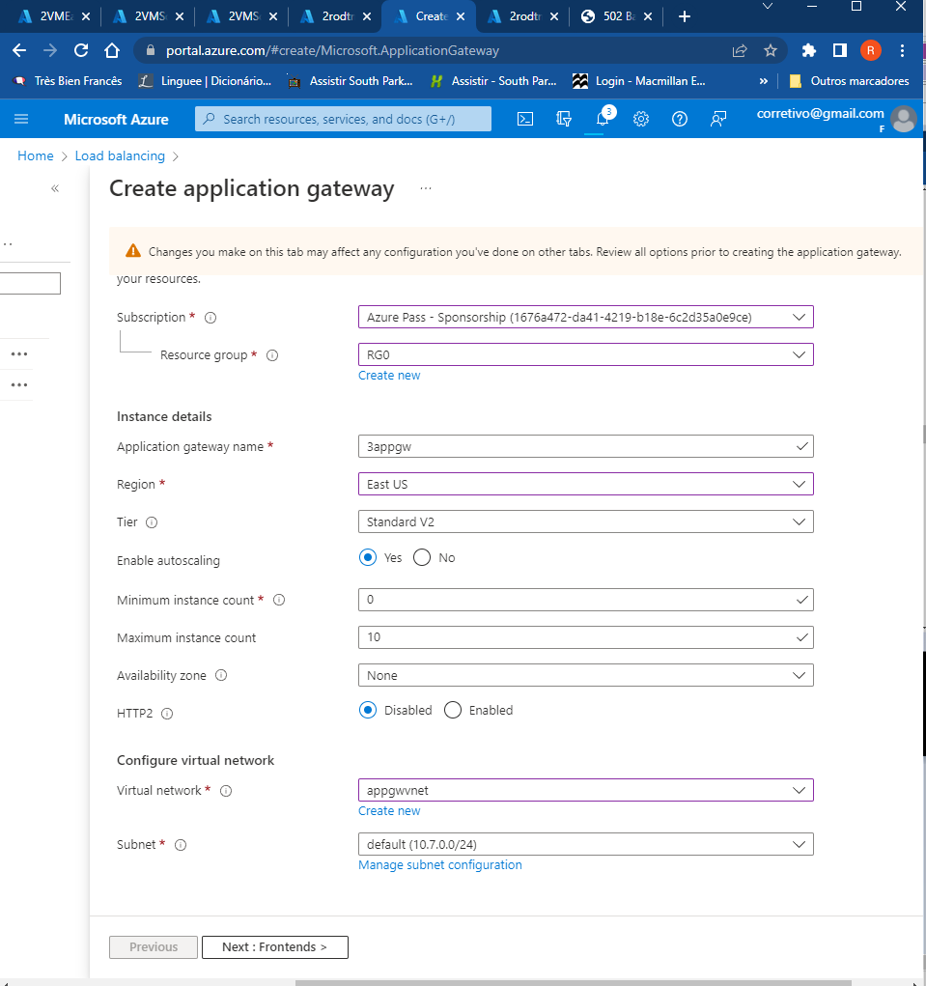
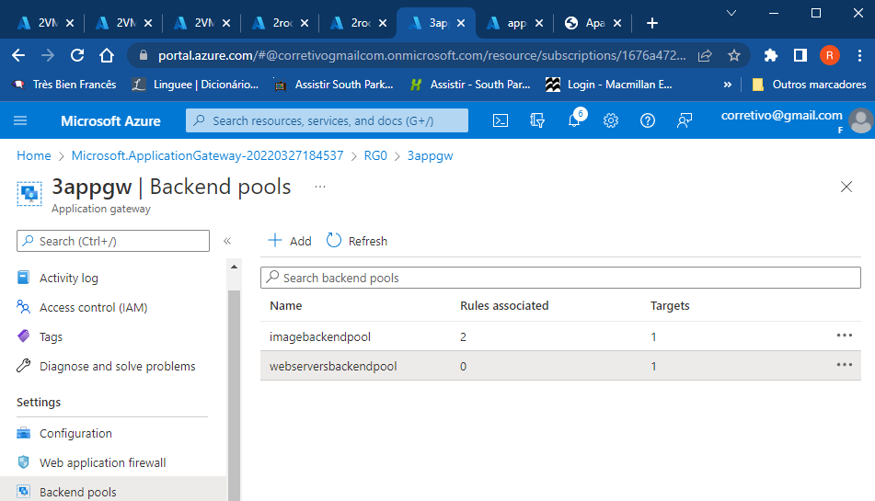
20

Slide 21
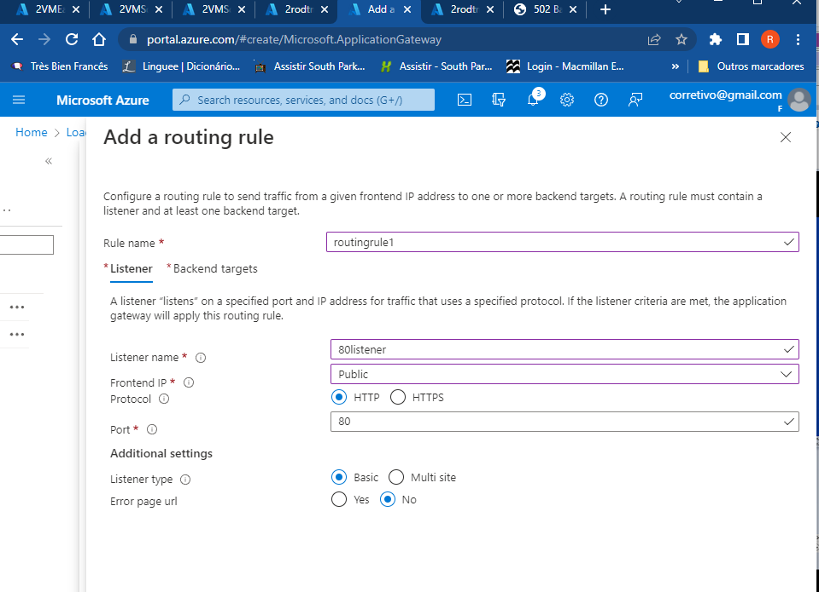
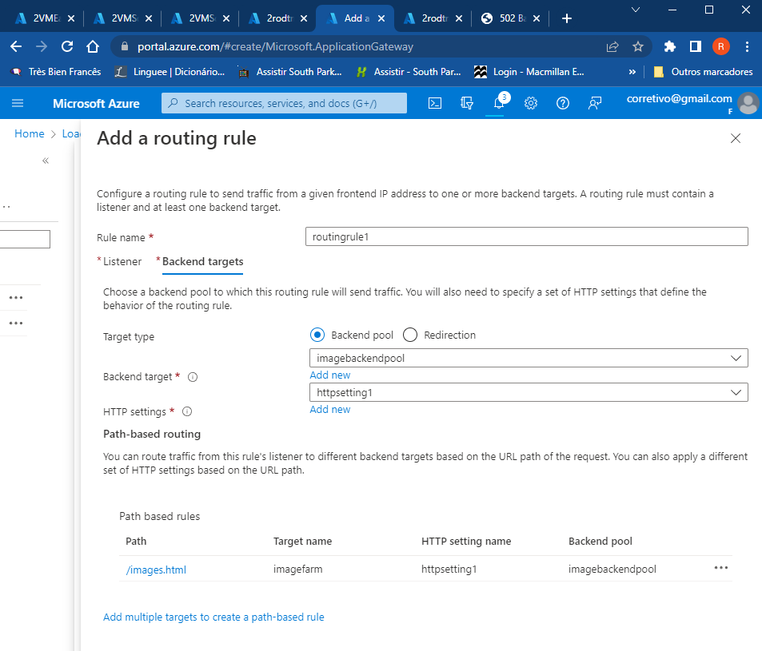
21

Slide 22
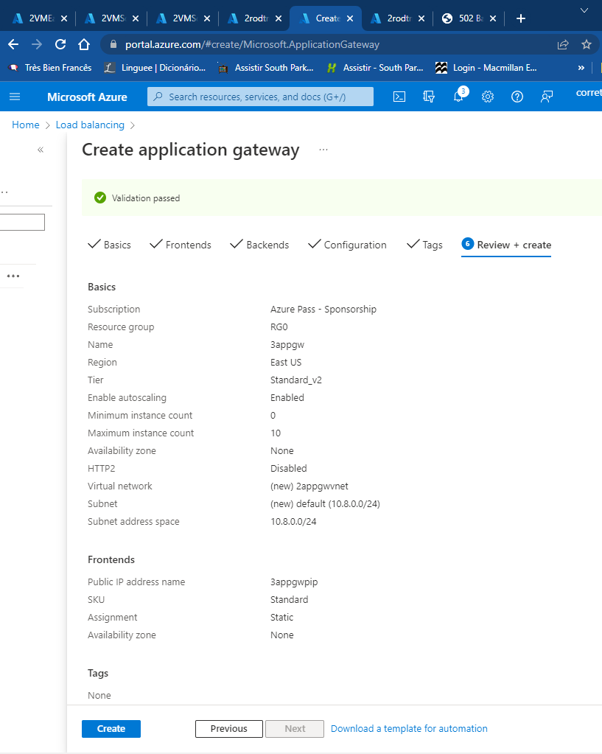
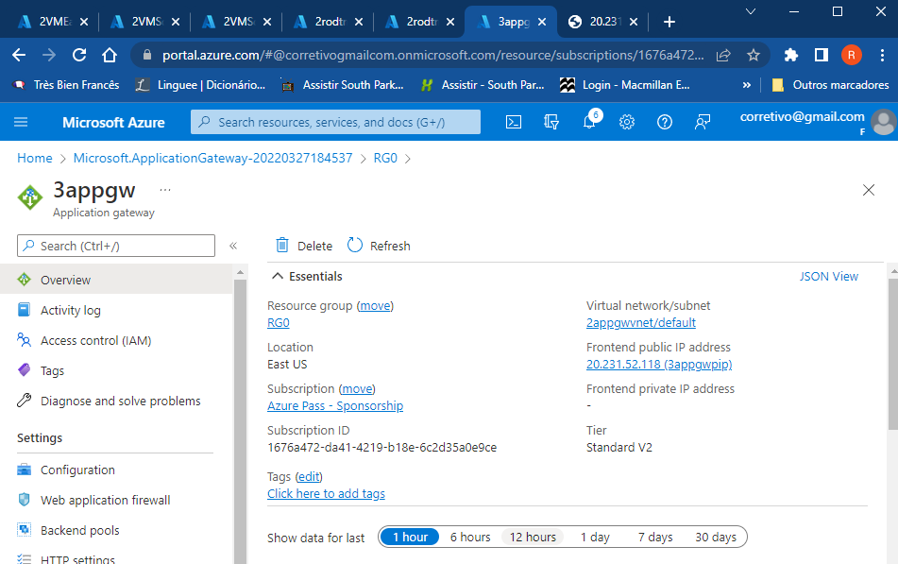
22

Slide 23

AZURE FRONT DOOR

Slide 24
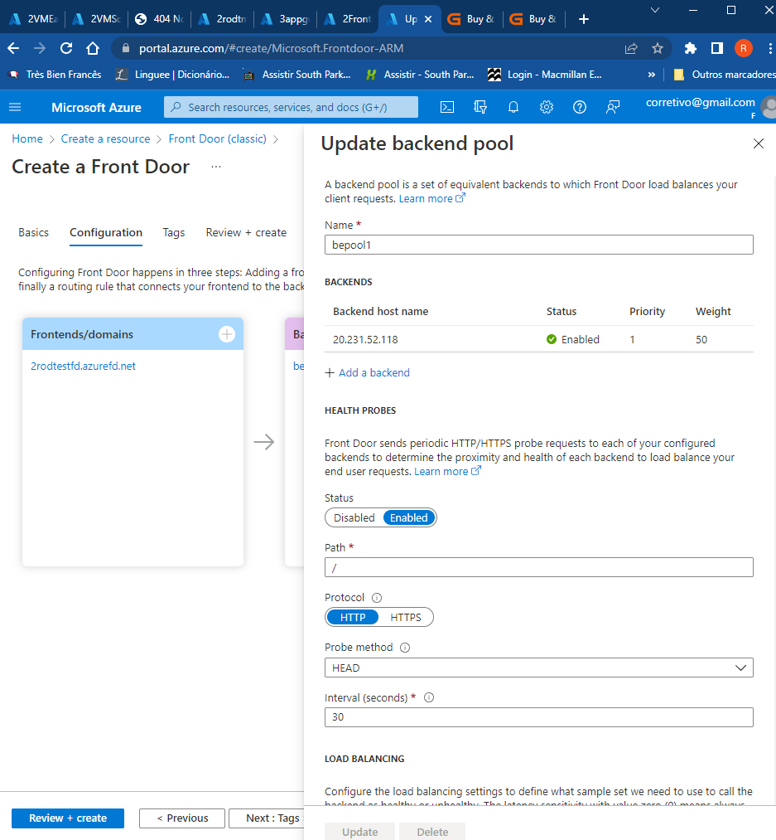
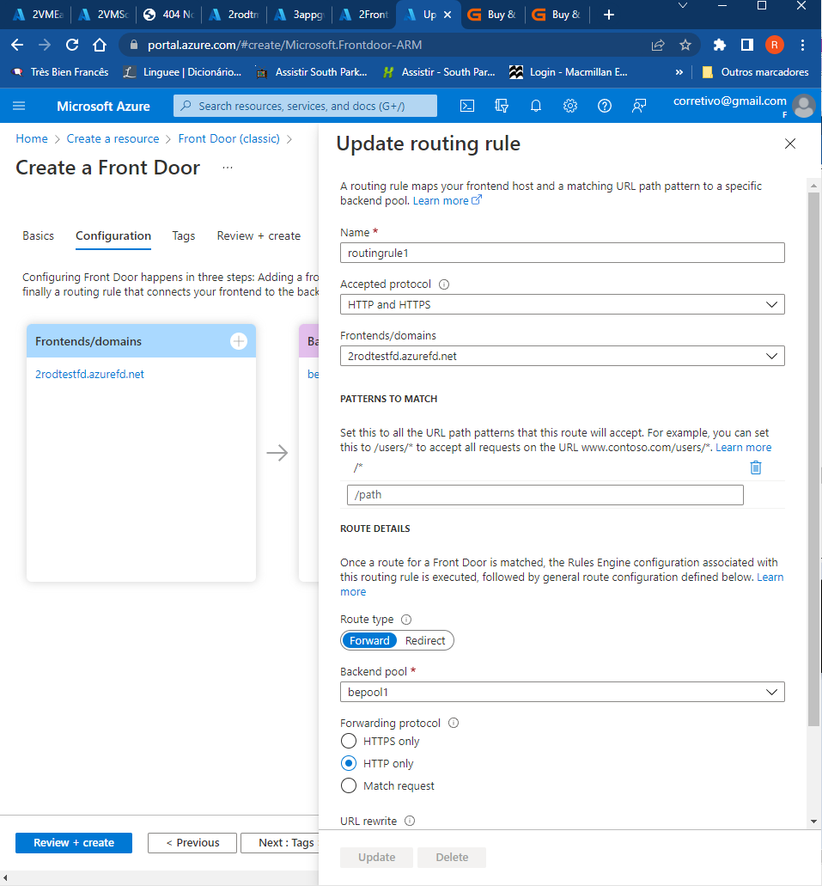
24

Slide 25
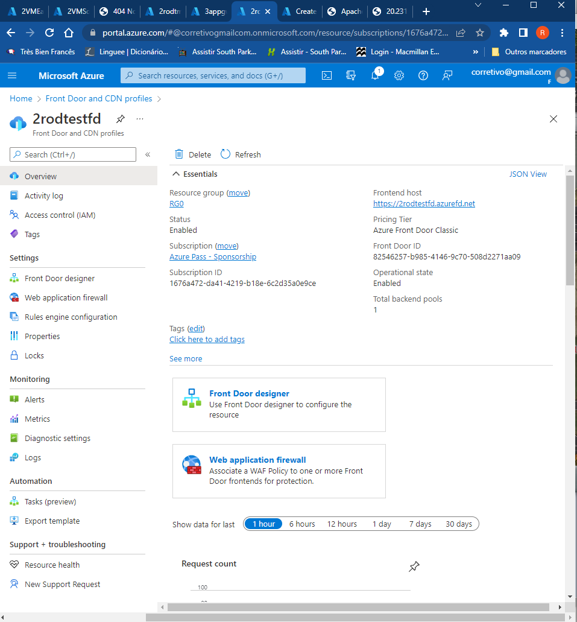
25

Slide 26

FEATURES OF TERRAFORM
Effective solution to this issue, allowing administrators to rapidly deploy and reconfigure infrastructure all from one place, all at the same time. It is this ability especially that makes Terraform so powerful.
Generate and execute plans based on your desired end state and re-provision infrastructure based on configuration changes.

Slide 27







FEATURES OF TERRAFORM
Inject secrets into Terraform
Can use modules and variables to avoid repetitive work
Input/output variables
Show error and success message
Integrates with multi tools
Terraform workstation

Slide 28

HOW TO USE TERRAFORM:
INSTALL IT USING YOUR FAVORITE CLI USING THIS SIMPLE TUTORIAL:
https://learn.hashicorp.com/tutorials/terraform/install-cli

Slide 29
HOW TO USE TERRAFORM:
Write
Plan
Apply
1
2
3
4
WRITE - the IaC in HCL using blocks, arguments, variables, and expressions using your favorite text editor
PLAN - Run terraform plan to get a preview of the modifications that will be made to the environment. The plan output will notate what will be added, destroyed, and changed.
APPLY - If satisfied with the plan output, run terraform apply to apply the desired changes to reach your desired state.
DESTROY – Tear down your environment with a single command

Slide 30
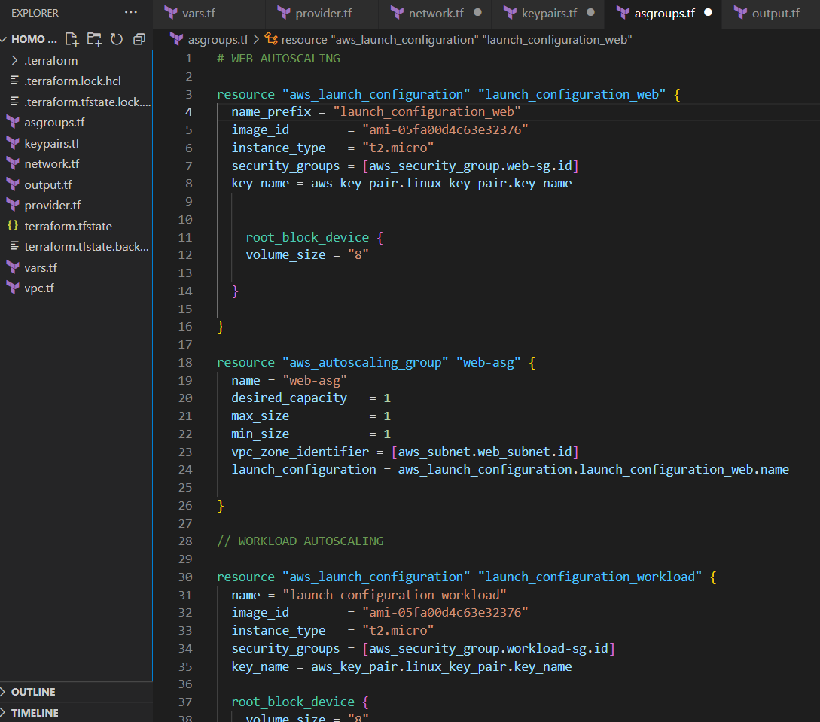
EXAMPLE OF TERRAFORM CODE
29

Slide 31
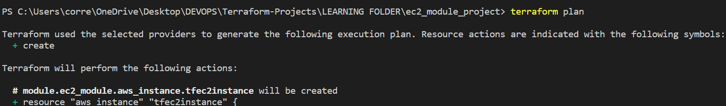
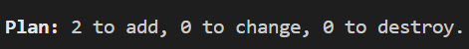
PLAN:
30

Slide 32
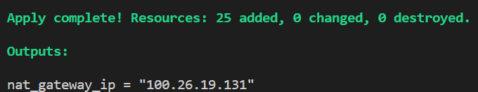
Success example with OUTPUTS:
31

Slide 33
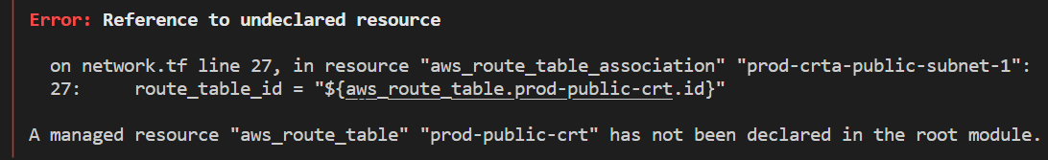
ERROR EXAMPLE:
32

Slide 34



HOW DOES IT WORK?
Terraform core has two entries:
Configuration Files - scripts we write to the configuration we desire
State files – the actual state of the terraform managed environment
JSON-like configuration language called HCL (HashiCorp Configuration Language)
Cloud providers provision the infrastructure

Slide 35






COMMOM USE CASES FOR TERRAFORM
Automate orchestration on a large, heterogeneous system that involves multi-cloud and hybrid cloud platforms
Scale up and down the infrastructure according to variable online workloads
Deploy large system with complex topology
Apply repeated, clearly defined procedures on cloud resources
Manage Kubernetes

Slide 36

COMMOM USE CASES FOR TERRAFORM
Integrate with existing workflows
Enforce policy as a code

Slide 37
KEY TAKEAWAYS
Manage any infrastructure
Track your infrastructure
Automate changes
Standardize configurations
Collaborate

Slide 38
Q&A

Slide 39
THANK YOU!
Rodrigo Fernandes, September 19, 2022
rodrigoefernandes@gmail.com

